Slide 1
Strengthening Network Security Posture and Threat Detection with Cyber Canary
Javeriya Vahid SRN: R21MTC55 | Date: 20/09/2024
M.Tech in
Cybersecurity
Capstone Project Presentation
Year: 2

Slide 2
01 Introduction
Background | Current status | Why this study
07 Software Design
High Level | Low Level Design Diagrams
02 Literature Review
Seminal works | Summary | Research Gap
08 Implementation
Demo | Application | Use cases
03 Problem Statement
Technical | Functional Problem
09 Testing and Validation
Test Results | Learnings
Agenda
04 Project Objectives
Primary & Secondary Objectives | Expected Outcome
10 Analysis and Results
Key Findings | Insights
05 Project Methodology
Conceptual Framework | Research Design
11 Suggestions and Conclusions
Insights | Next Step | Future Scope
06 Resource Specification
Software | Hardware
12 Annexure
References | Publications | Plagiarism Score

Slide 3
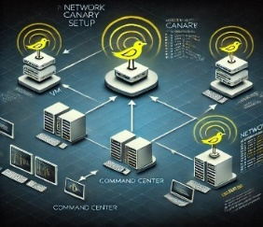


Introduction
Cyber Canary: Cyber Canaries are intentionally placed vulnerable assets designed to mimic real systems in the network.
Early Warning System: These canaries trigger alerts at the first sign of suspicious activity, providing an early warning against potential cyber threats.
Proactive Defense: By swiftly detecting anomalies and unauthorized access, Cyber Canaries empower security teams to proactively defend against evolving cyber threats.

Slide 4

Background Information
Inspired by the Canaries in a coal mine, these Canaries, whether in embedded hardware or software, act as early warning systems.
Their primary goal is to disrupt the lateral movement of threats by swiftly detecting and signalling potential dangers.
The project addresses the limitations of traditional perimeter defences, providing a proactive layer of defence for modern cybersecurity.
Cyber Canaries aim to minimize the impact of both external and internal cyberattacks and enhance overall network resilience.

Slide 5

Literature Review
No. | Title | Author and Year | Journal | Description | Insights | Research Gaps/Comments
1 | Evaluate Canary Deployment Techniques using Kubernetes | Srinivas Venkatraman , Antra Malhotra, 2024 | IEEE Access | This paper assesses various code deployment techniques and explores how Kubernetes and Istio can facilitate zero-downtime canary deployments. | It highlights the Kubernetes and Istio, liquibase as key tools for achieving zero-downtime canary deployments, ensuring seamless service updates. | The paper does not address the potential vulnerabilities introduced by using third-party tools like Istio and Liquibase in the deployment pipeline.
2 | Honeypot Method to Lure Attackers Without Holding Crypto-Assets | HIRONORI UCHIBORI , KATSUNARI YOSHIOKA, 2024 | IEEE Access | A new RPC( Remote Procedure Call) honeypot that uses fake wallet addresses to attract and observe attackers without risking real crypto-assets | The RPC honeypot technique lures attackers with fake wallet addresses, allowing for detailed analysis of attacks without risking real crypto-assets. | The fake wallet addresses might not capture all aspects of real-world attacks, potentially limiting analysis accuracy.
3 | Securing your network with Honeypot, canary tokens and Docker on AWS | N.C. Brintha, Vikrant Vijaybhai Joliya,2023 | IEEE 2023 International Conference on Computational Intelligence and Sustainable Engineering Solutions (CISES) | It describes employing honeypots and Canary tokens on Docker and AWS to improve security by monitoring and analyzing hacker behavior. | Honeypots and Canary tokens offer a cost-effective way to detect and analyze cyber threats, improving overall network security. | The effectiveness of honeypots and Canary tokens may vary in different attack scenarios or with advanced threat techniques.

Slide 6
Literature Review
No. | Title | Author and Year | Journal | Description | Insights | Research Gaps/Comments
4 | Present and Future of Network Security Monitoring | MARTA FUENTES-GARCÍA 1, JOSÉ CAMACHO 2, AND GABRIEL MACIÁ-FERNÁNDEZ, 2021 | IEEE ACCESS | It explores the latest trends in Network Security Monitoring (NSM) and offers a new framework for classifying and evaluating NSM systems and tools. | Network Security Monitoring(NSM)system evaluation and addresses current network security challenges | The paper highlights the need for further research on how the new framework can be applied to emerging network technologies and evolving security threats.
5 | Economic Analysis of Canary-Based Prognostics and Health Management | Wenbin Wang and Michael Pecht,2011 | IEEE Transactions on Industrial Electronics | The paper presents a cost-based model for determining the economic value and optimal replacement timing of canary devices in prognostics and health management (PHM). | The model offers an approach to assessing the canary devices and scheduling preventive maintenance to optimize system replacement timing. | Further research is needed to adapt the model for various industries and incorporate additional factors affecting canary device performance and maintenance

Slide 7
Problem Statement
Analyzing the type of attack takes time. The honeypots can't be used effectively inside the network beyond DMZ.
Typical honeypots involve significant analysis overhead require specialized staff to identify inbound attacks and are generally not designed to configure or simulate new scenarios beyond their intended purpose.
There is also the challenge of mapping the attacks with real-time vulnerabilities so that the attack can be identified at an earlier stage to protect the network.

Slide 8

Project Objectives
Develop an adaptable Network Setup for Cyber Canary.
Map with OWASP Top 10 threat Categories.
Implement intelligent signaling mechanisms within the Cyber Canary system.
Integrate the alert signaling with the centralized server for better monitoring.

Slide 9
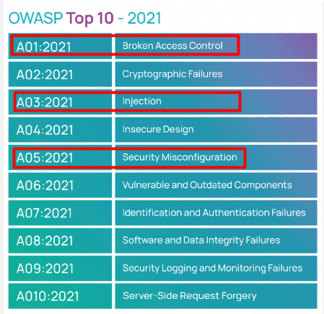
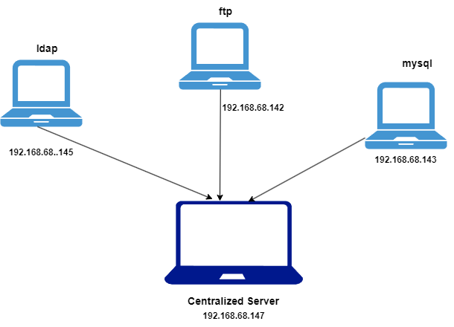

Project Methodology
Methods Involved
Network Setup & Configuration
Deployment of Vulnerable Machines
Simulation of Attacks
Detection by Cyber Canary
Centralized Log Forwarding
Simulation of Attacks
Cyber Canary Network

Slide 10
Resource Specifications
Physical Computer Requirement
Linux Virtual machine Requirement
Resource | capacity
CPU | At least Quad-core processor (Intel i5 or higher)
RAM | 16GB
Storage | 256GB SSD
Resource | Capacity
CPU | 2 VCPU
RAM | 4GB
Disk Space | 50GB

Slide 11
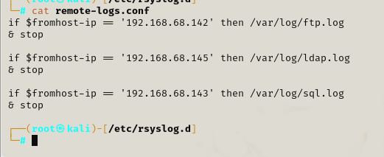
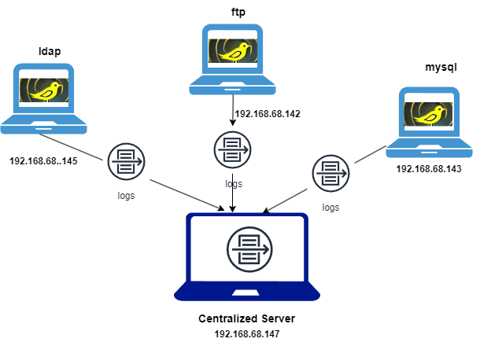
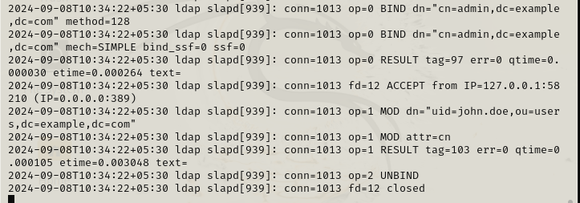
Software Design
Centralized Logging: rsyslog
Logs at centralized server
Cyber Canary Setup

Slide 12

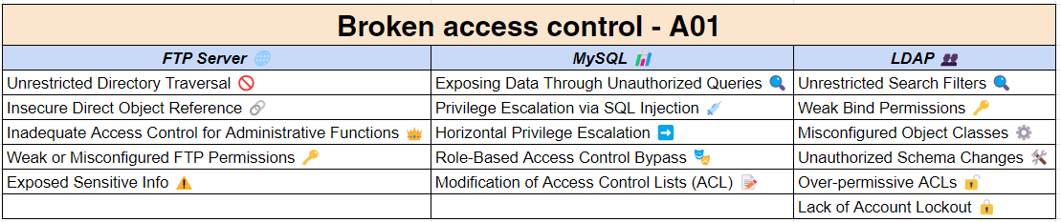

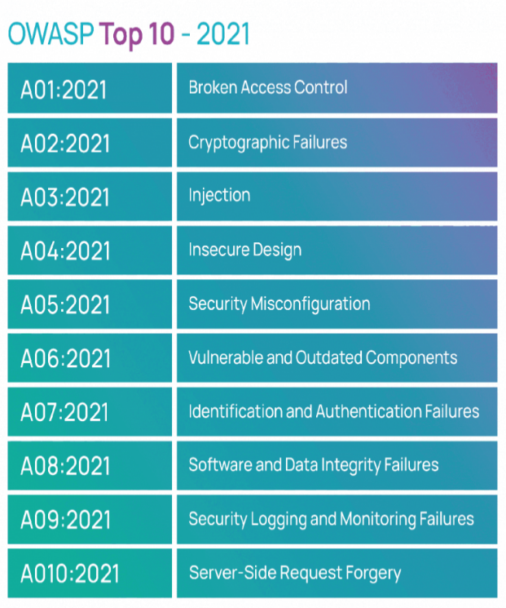
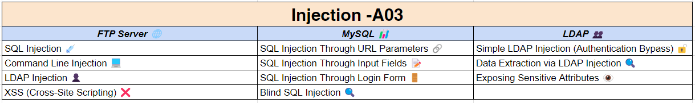


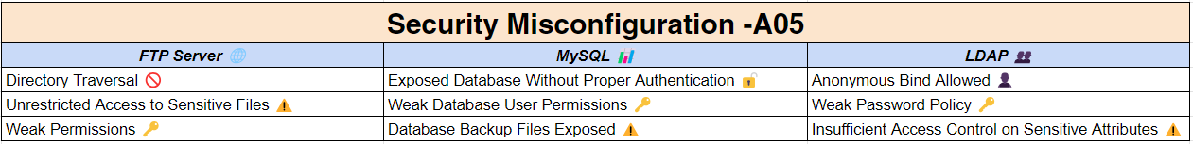
IMPLEMENTATION- OWASP
The OWASP Top 10 highlights the most critical web application security risks, guiding developers to prioritize and address key vulnerabilities.
Considered following for assessment and validation under this project scope.

Slide 13
Demo
Capstone 2 Demo Link

Slide 14

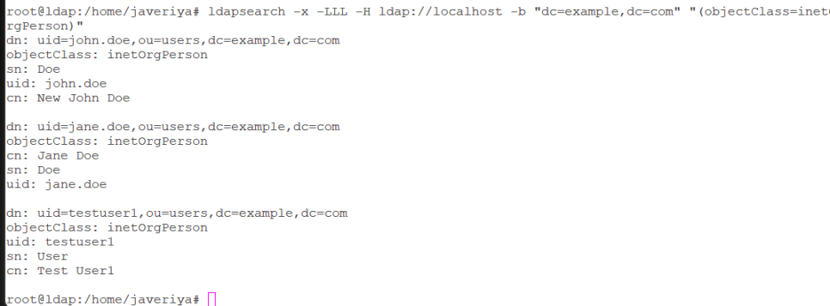
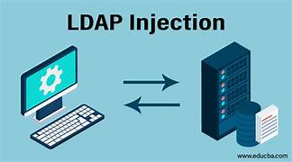
Testing and Validation
LDAP
Broken Access Control
uid = *
Injection
Global search for object

Slide 15
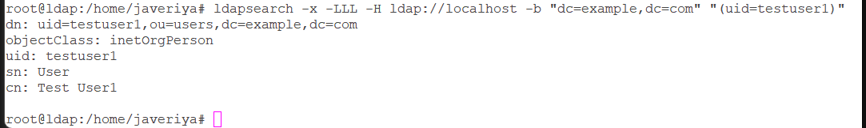

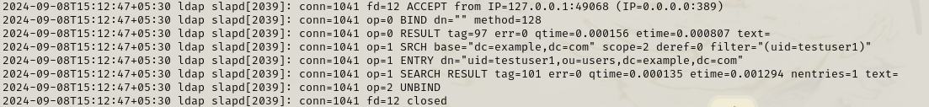
Testing and Validation
LDAP
Security Misconfiguration
Misconfigured directory permissions
Logs at the centralized Server

Slide 16

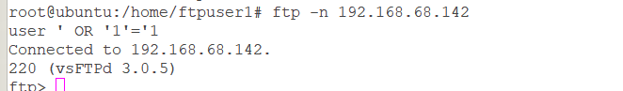

Testing and Validation
FTP
Broken Access Control
Injection
Improper Access to User or File
Using Injection Queries

Slide 17

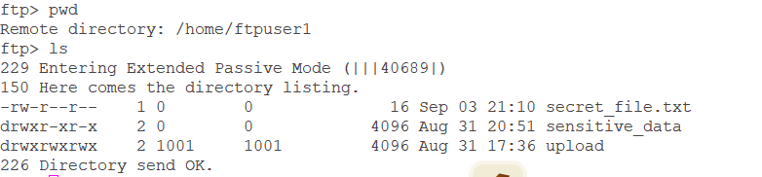
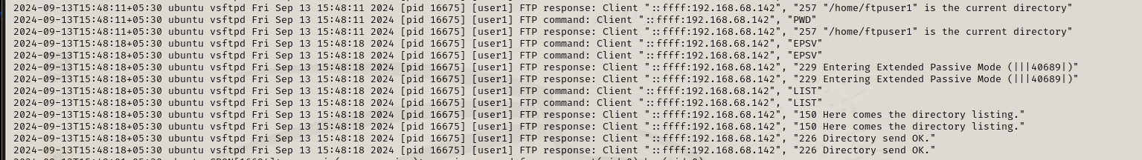

Testing and Validation
Security Misconfiguration
FTP

Slide 18
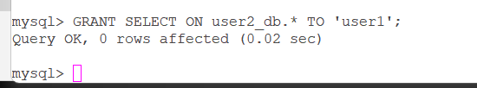

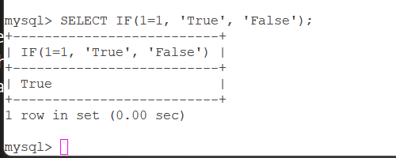

Testing and Validation
MySQL
Broken Access Control
Excess Access
Injection
SQL Injection

Slide 19
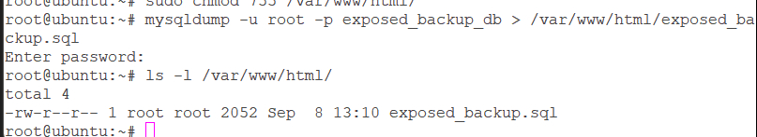

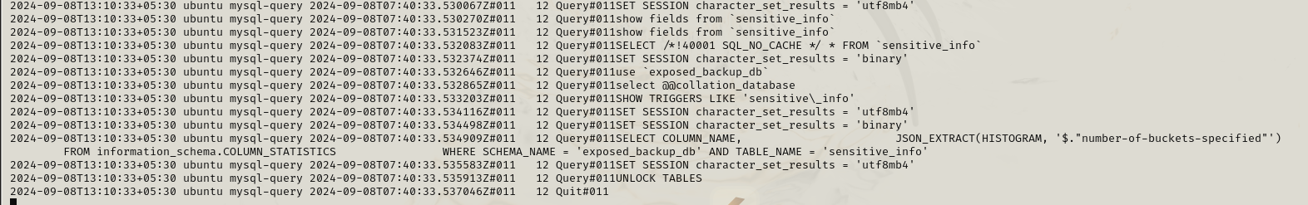

Testing and Validation
Security Misconfiguration
MySQL
Exposing the data

Slide 20
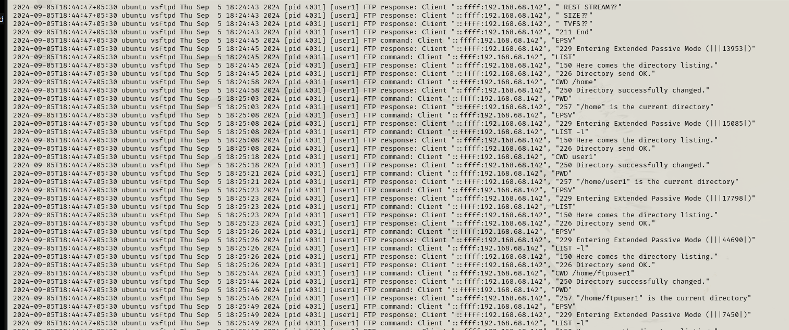
Analysis and Results
FTP LOGS

Slide 21
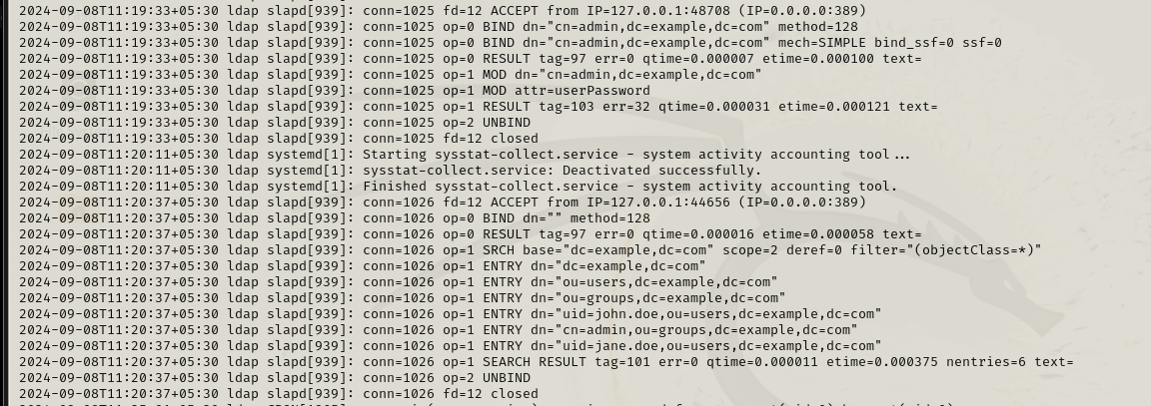
Analysis and Results
LDAP LOGS

Slide 22
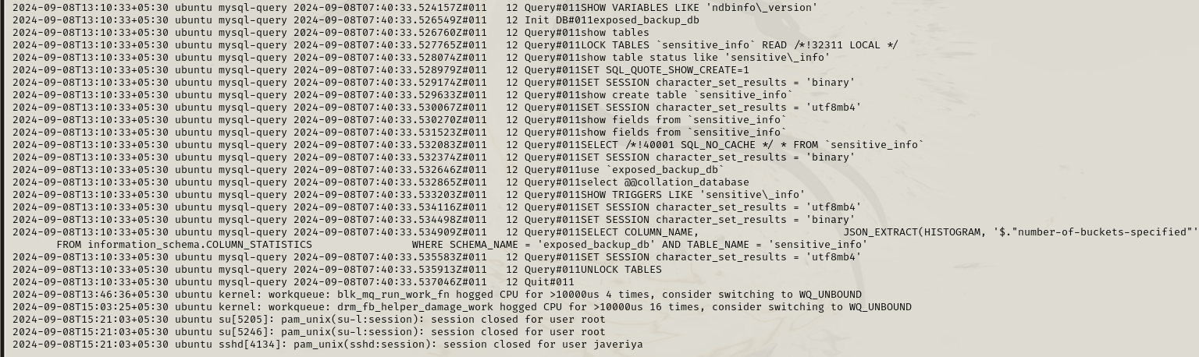
Analysis and Results
MYSQL LOGS

Slide 23
Suggestions and Conclusion
Key Achievements of Cyber Canary Include:
Effective Early Warning System
Seamless Integration with OWASP Top 10 selected controls.
No Impact on Network’s Performance
Scalable and Flexible – add more Cyber Canaries on-demand for specific needs.
Provides a cost-effective solution when compared to honeypots
Could be mapped with MITRE ATT&CK Framework’s Tactics, Techniques, and Procedures (TTPs).

Slide 24
References
[1] V. S. Malhotra Antra, “Evaluate Canary Deployment Techniques Using-1,” Digital Object Identifier 10.1109/ACCESS.2024.341608, Jun. 2024.
[2] H. Uchibori, K. Yoshioka, and K. Omote, “Honeypot Method to Lure Attackers Without Holding Crypto-Assets,” IEEE Access, vol. 12, pp. 16059–16071, 2024, doi: 10.1109/ACCESS.2024.3357785
[3] N. C. Brintha, V. V. Joliya, G. Bhuvnesh, and S. Malini, “Securing your network with Honeypot, Canerytokens and Docker on AWS,” in Proceedings of International Conference on Computational Intelligence and Sustainable Engineering Solution, CISES 2023, Institute of Electrical and Electronics Engineers Inc., 2023, pp. 683–687. doi: 10.1109/CISES58720.2023.10183431.

Slide 25
References
[4] T. Ünlü, L. A. Shepherd, N. Coull, and C. McLean, “Poster: Angry birding: Evaluating application exceptions as attack canaries,” in Proceedings - 2021 IEEE European Symposium on Security and Privacy, Euro S and P 2021, Institute of Electrical and Electronics Engineers Inc., Sep. 2021, pp. 701–703. doi: 10.1109/EuroSP51992.2021.00052.
[5] H. Uchibori, K. Yoshioka, and K. Omote, “Honeypot Method to Lure Attackers Without Holding Crypto-Assets,” IEEE Access, vol. 12, pp. 16059–16071, 2024, doi: 10.1109/ACCESS.2024.3357785.
[6] W. Wang and M. Pecht, “Economic analysis of canary-based prognostics and health management,” IEEE Transactions on Industrial Electronics, vol. 58, no. 7, pp. 3077–3089, Jul. 2011, doi: 10.1109/TIE.2010.2072897.

Slide 26
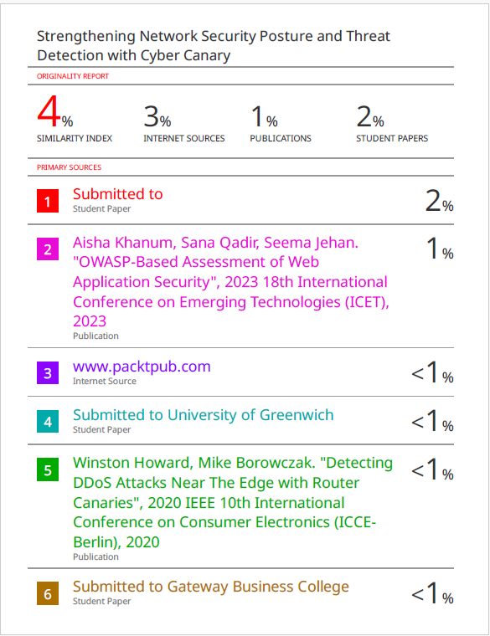

Annexure

Slide 27
Annexure
Publications | Conferences

Slide 28
GitHub Link
https://github.com/Javeriya123/Cyber-Canary--with-owasp

